Slide 1


Slide 2
About the company

Slide 3
About the company
Atliq Hardwares is one of the leading computer hardware producers in India and also expanded in 27 other countries.

Slide 4
About the company
Atliq Hardwares is one of the leading computer hardware producers in India and also expanded in 27 other countries.
Atliq hardwares is operating in regions like APAC, Latin America, North America and EU.

Slide 5
About the company
Atliq Hardwares is one of the leading computer hardware producers in India and also expanded in 27 other countries.
Atliq hardwares is operating in regions like APAC, Latin America, North America and EU.
The company sells products under 14 different category like Personal Computers, graphics cards, processors and other accessories.

Slide 6
About the company
Atliq Hardwares is one of the leading computer hardware producers in India and also expanded in 27 other countries.
Atliq hardwares is operating in regions like APAC, Latin America, North America and EU.
The company sells products under 14 different category like Personal Computers, graphics cards, processors and other accessories.
Atliq hardware have 74 customers across the world. Some of them are Flipkart, Amazon, Croma and others.

Slide 7
Problem Statement

Slide 8
Problem Statement
Atliq hardware has 10 ad-hoc requests for which we have to generate insights so that they can make quick and smart data-informed decisions.

Slide 9
Provide the list of markets in which customer "Atliq Exclusive" operates its business in the APAC region.
Request 1

Slide 10
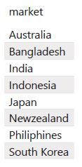
Provide the list of markets in which customer "Atliq Exclusive" operates its business in the APAC region.
Request 1

Slide 11
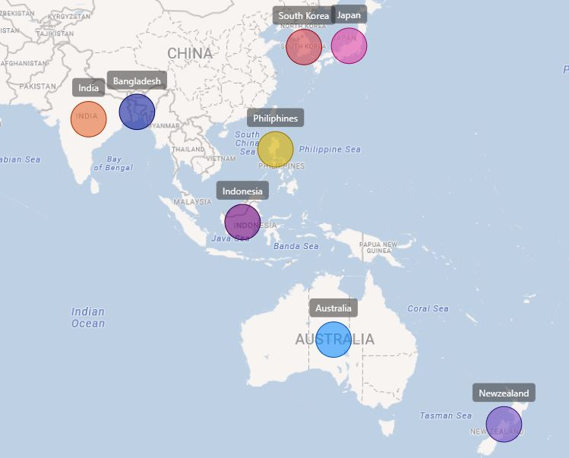
Provide the list of markets in which customer "Atliq Exclusive" operates its business in the APAC region.
Request 1

Slide 12
What is the percentage of unique product increase in 2021 vs. 2020?
Request 2

Slide 13
What is the percentage of unique product increase in 2021 vs. 2020?
Request 2

Slide 14
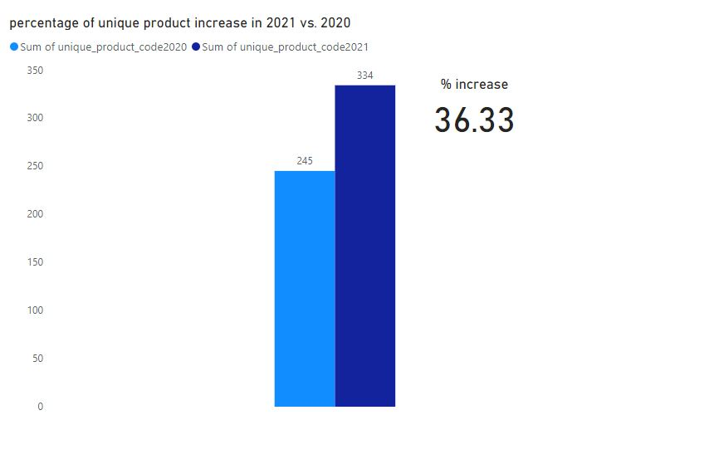
What is the percentage of unique product increase in 2021 vs. 2020?
Request 2

Slide 15
Provide a report with all the unique product counts for each segment
Request 3

Slide 16
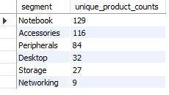
Provide a report with all the unique product counts for each segment
Request 3

Slide 17
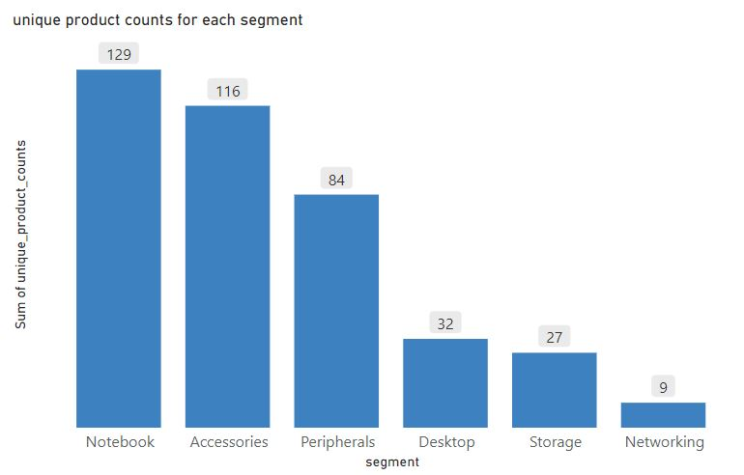
Provide a report with all the unique product counts for each segment
Request 3

Slide 18
Follow-up: Which segment had the most increase in unique products in 2021 vs 2020?
Request 4

Slide 19
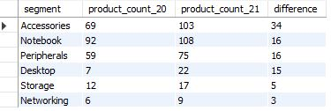
Follow-up: Which segment had the most increase in unique products in 2021 vs 2020?
Request 4

Slide 20
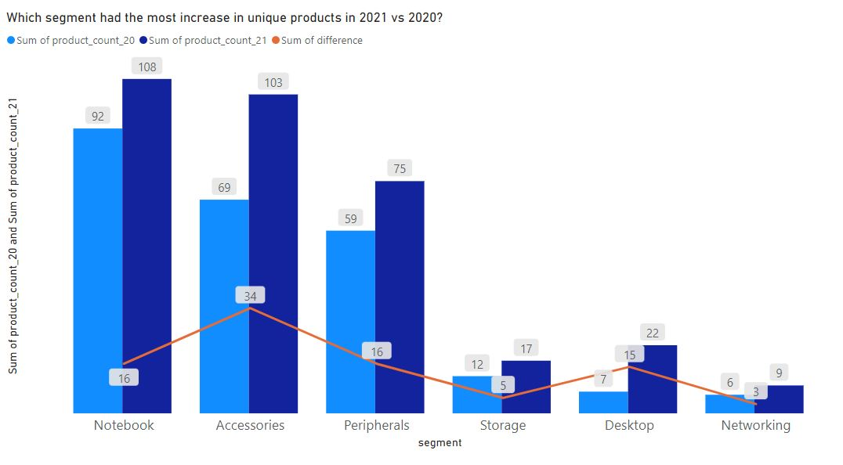
Follow-up: Which segment had the most increase in unique products in 2021 vs 2020?
Request 4

Slide 21
Get the products that have the highest and lowest manufacturing costs
Request 5

Slide 22

Get the products that have the highest and lowest manufacturing costs
Request 5

Slide 23
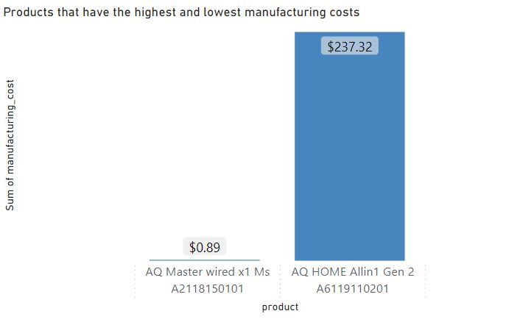
Get the products that have the highest and lowest manufacturing costs
Request 5

Slide 24
Get the products that have the highest and lowest manufacturing costs
Request 5
Mouse

Slide 25
Get the products that have the highest and lowest manufacturing costs
Request 5
PC

Slide 26
Top 5 customers in the Indian market who received an average high pre invoice discount % for the fiscal year 2021
Request 6

Slide 27
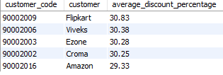
Top 5 customers in the Indian market who received an average high pre invoice discount % for the fiscal year 2021
Request 6

Slide 28
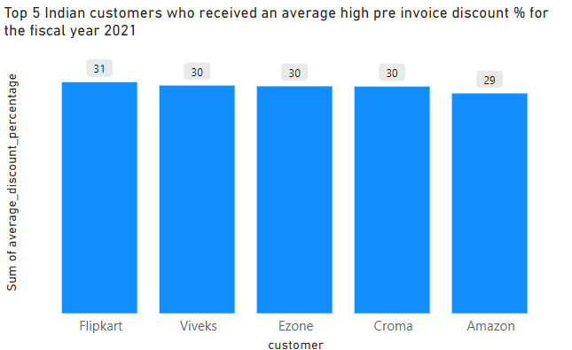
Top 5 customers in the Indian market who received an average high pre invoice discount % for the fiscal year 2021
Request 6

Slide 29
Get the complete report of the Gross sales amount for the customer “Atliq Exclusive” for each month
Request 7

Slide 30
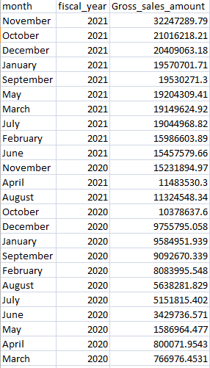
Get the complete report of the Gross sales amount for the customer “Atliq Exclusive” for each month
Request 7

Slide 31
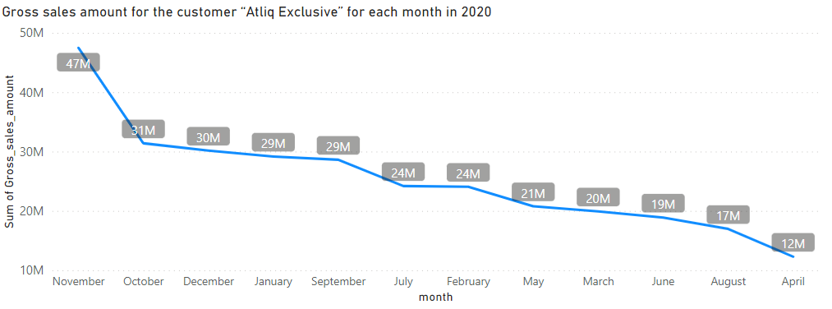
Get the complete report of the Gross sales amount for the customer “Atliq Exclusive” for each month
Request 7

Slide 32
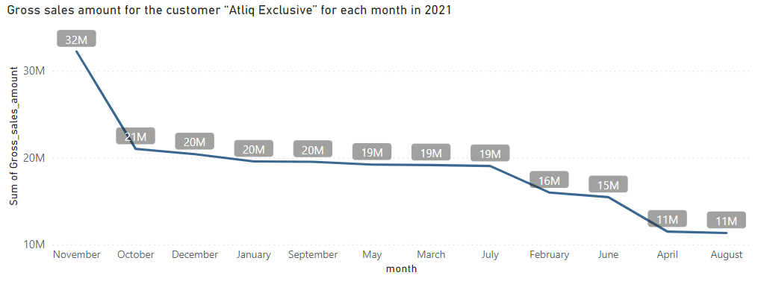
Get the complete report of the Gross sales amount for the customer “Atliq Exclusive” for each month
Request 7

Slide 33
In which quarter of 2020, got the maximum total_sold_quantity?
Request 8

Slide 34

In which quarter of 2020, got the maximum total_sold_quantity?
Request 8

Slide 35
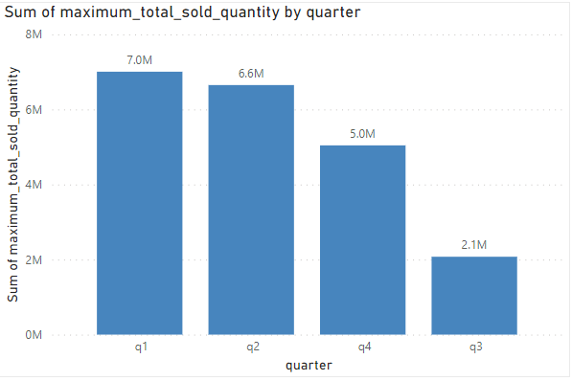
In which quarter of 2020, got the maximum total_sold_quantity?
Request 8

Slide 36
Which channel helped to bring more gross sales in the fiscal year 2021 and the percentage of contribution?
Request 9

Slide 37

Which channel helped to bring more gross sales in the fiscal year 2021 and the percentage of contribution?
Request 9

Slide 38
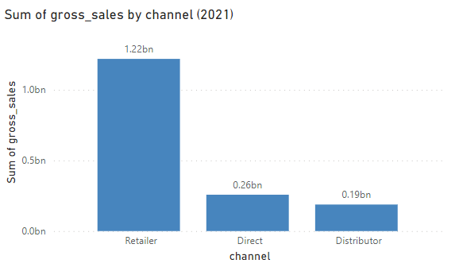
Which channel helped to bring more gross sales in the fiscal year 2021 and the percentage of contribution?
Request 9

Slide 39
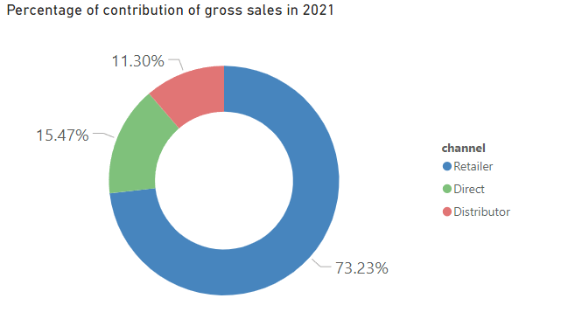
Which channel helped to bring more gross sales in the fiscal year 2021 and the percentage of contribution?
Request 9

Slide 40
Get the Top 3 products in each division that have a high total_sold_quantity in the fiscal_year 2021
Request 10

Slide 41
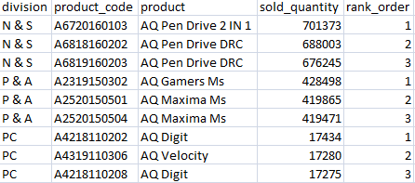
Get the Top 3 products in each division that have a high total_sold_quantity in the fiscal_year 2021
Request 10

Slide 42
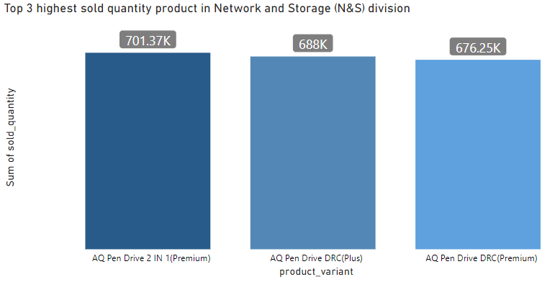
Top 3 products in the Network and Storage division (N&S) that have a high total_sold_quantity
Request 10

Slide 43
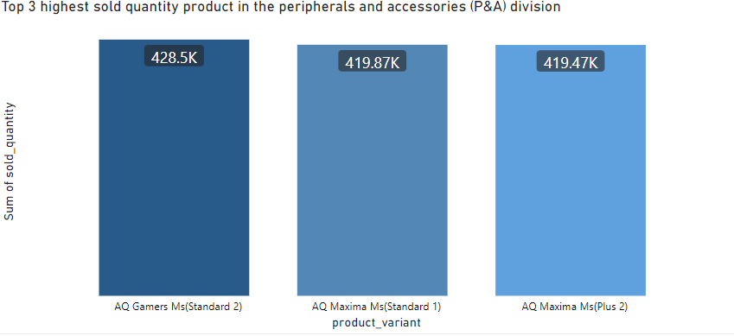
Top 3 products in the Peripherals and accessories division (P&A) that have a high total_sold_quantity
Request 10

Slide 44
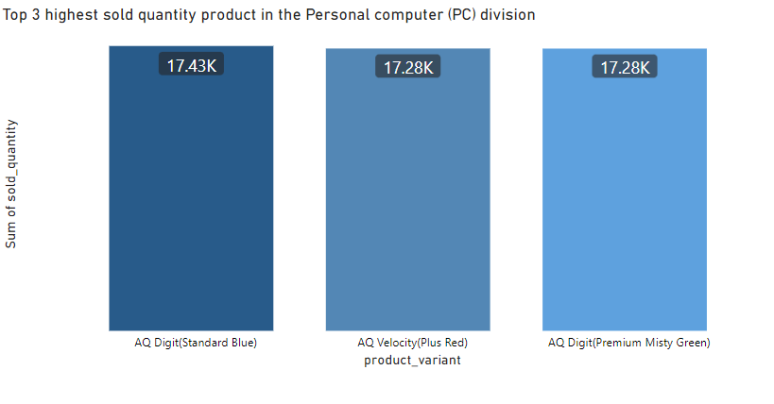
Top 3 products in the Personal Computer division (PC) that have a high total_sold_quantity
Request 10

Slide 45
Thank You

